Slide 1

Imperial college london
2023 May 9th
Machine learning methods for DBT imaging
Student
Omar Eweis

Slide 2
Background breast cancer
Breast cancer is the second most deadly cancer for women (1)
12,000 people die from breast cancer on average yearly
700 million pound burden in the uk costing NHS 12,595 to treat patients 15 months after diagnosis (2)
The solution: early and more effective breast cancer screening to diagnose breast cancer earlier
2
Notes:
1.Lfbc.org.uk. (2022). BREAST CANCER FACTS – Ladies Fighting Breast Cancer. [online] Available at: https://lfbc.org.uk/support/breast-cancer-facts/#:~:text=Breast%20Cancer%20is%20the%20second,the%20UK%2C%20after%20lung%20cancer.&text=The%20biggest%20risk%20factor%2C%20after,over%20the%20age%20of%2050.&text=Of%20adults%20aged%20between%2025,45%25%20of%20all%20female%20cancers. [Accessed 8 May 2023].
2.Morton, R., Sayma, M. and Sura, M. (2017). Economic analysis of the breast cancer screening program used by the UK NHS: should the program be maintained? Breast Cancer: Targets and Therapy, [online] Volume 9, pp.217–225. doi:https://doi.org/10.2147/bctt.s123558.
Cnn are a way to speed up the process
‌
‌

Slide 3
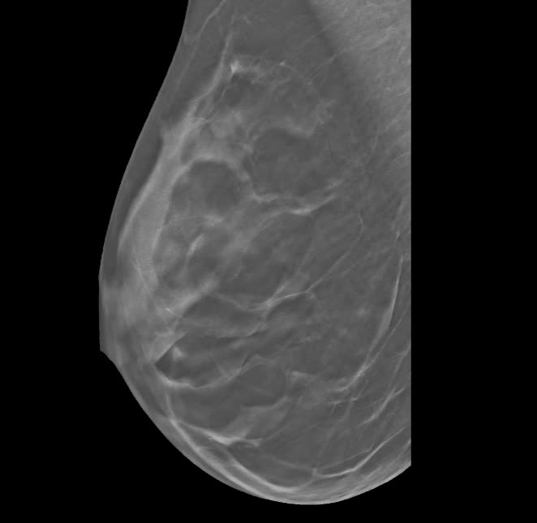
Background dbt (Digital Breast Tomosynthesis)
the standard was 2d ct-mammography
lower resolution 2d image uses ionizing radiation and dye
dbt shows an improved quasi 3d image
Noninvasive, uses less ionization radiation
By 2021 over 75% of mammographic clinics own a dbt machine
3

Slide 4
Aim
evaluate machine learning-based methods (CNN, random forest, XGboost, clustering) in classifying breast images
evaluate the potential of 3d methods of analysis for dbt compared to 2d methods of analysis
4

Slide 5
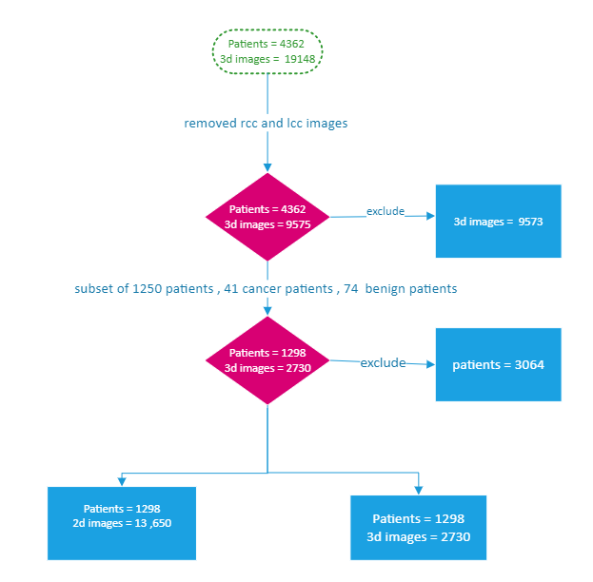
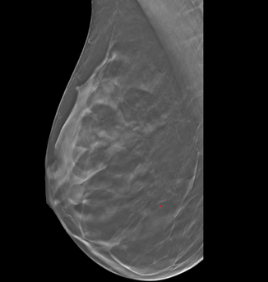
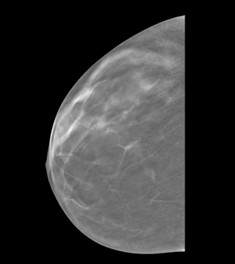
Pre-processing (Exclusion)
left mediolateral oblique view
left craniocaudal view
2D analysis
3D analysis
5

Slide 6
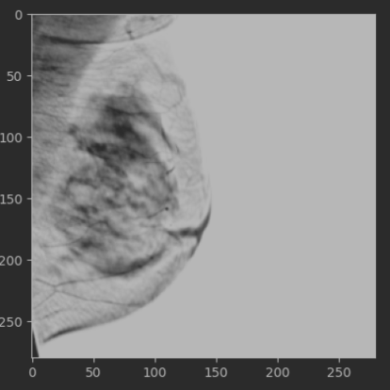
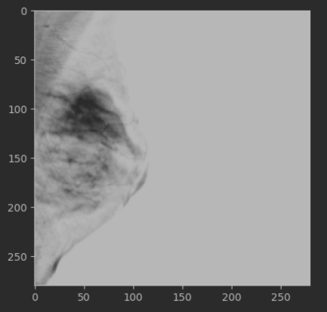
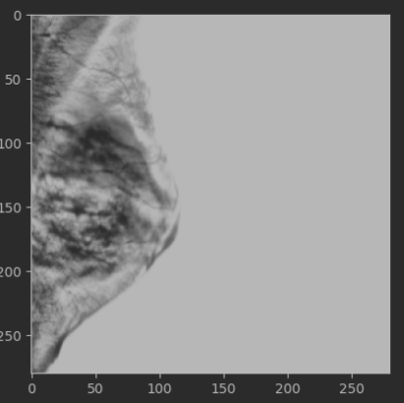
Pre-processing (images/videos)
Videos ranged from 40-60 slices and had a resolution of>1000
Resized all images to (5,280,280) 5 slices width and height of 280
Applied crop removing 1/8 of every image and normalization using a mask for each photo
Truncation: removing pixel intensities not within the 5th to 99th percentile
Normalization: to normalize between 0 and 1
contrast-limited adaptive histogram equalization (CLAHE) enhance contrast in cancer and benign images
Trunc. and norm.
Resized image (280,280)
CLAHE
6

Slide 7
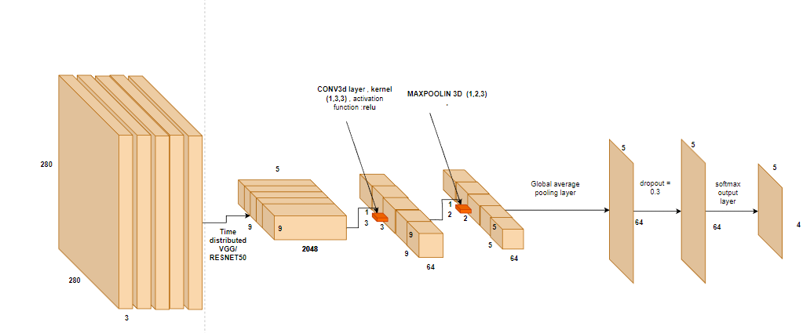
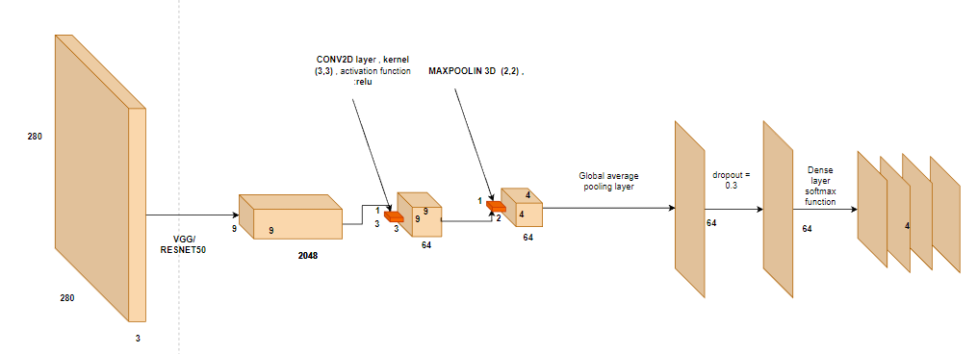
Methods ( CNN models)
Time distributed 3d-cnn
Input
output
2730,5,280,280,3
2730,5,4
2d cnn
13650,5,280,280,3
13650,4
7

Slide 8
Methods decision trees and clustering
FEATURE SELECTION
3d cnn:
removed the last two layers of the 3d-cnn to get output of features ( 2730,64)
2d cnn:
removed the last two layers from the VGG16/ResNET50 to extract features
feature output = 13650,4096
ran tuned clustering (Kmeans , HDBSCAN) and decision trees (random forest and XGboost)
8

Slide 9
Methods (tuning)
CNN: Grid search on a random subset of 1000 including all cancer and benign cases
'learning_rate': [1e-4, 1e-5, 1e-6],
'dropout_rate': [0.3, 0.4, 0.5]
Decision Trees: Grid search and cross-validation
grid = GridSearchCV(estimator=model, param_grid=param_grid, cv=3, n_jobs=-1)
xgb_param_grid = {
'n_estimators': [100, 200, 500],
'max_depth': [5, 10],
'learning_rate': [0.01, 0.1, 1],
'subsample': [0.5, 0.75, 1],
'colsample_bytree': [0.5, 0.75, 1],
Clustering: consensus clustering using min cluster size and silhouette score
Training = 60%
Test set = 20%
Validation = 20%
grid search , cross validation =3,5
9

Slide 10
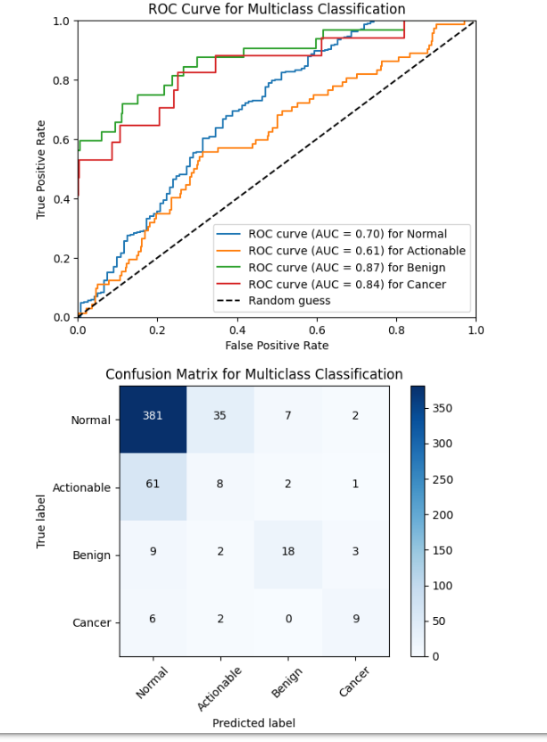
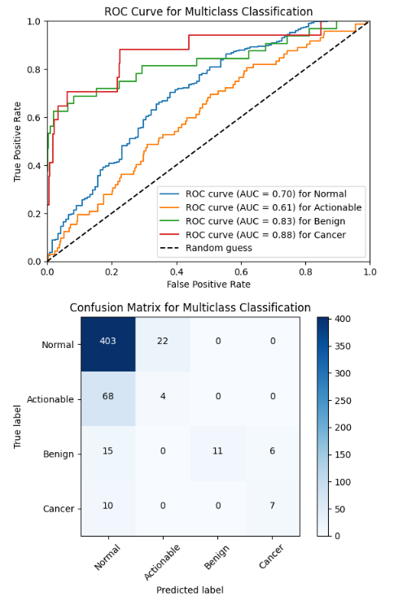
Results CNN 3D
RESNET50
VGG16
 | RESNET50 | VGG16
Overall accuracy | 0.76 | 0.78
Overall sensitivty | 0.52 | 0.44
Overall specificity | 0.82 | 0.79
Overall f1 score | 0.54 | 0.48
Normal sensitivity | 0.89 | 0.94
Actionable sensitivty | 0.11 | 0.055
Benign sensitivity | 0.56 | 0.34
Cancer senistivity | 0.52 | 0.41
Normal specificity | 0.37 | 0.23
Actionable specificity | 0.91 | 0.95
Benign specificity | 0.98 | 1
Cancer specificity | 0.98 | 0.99
10

Slide 11
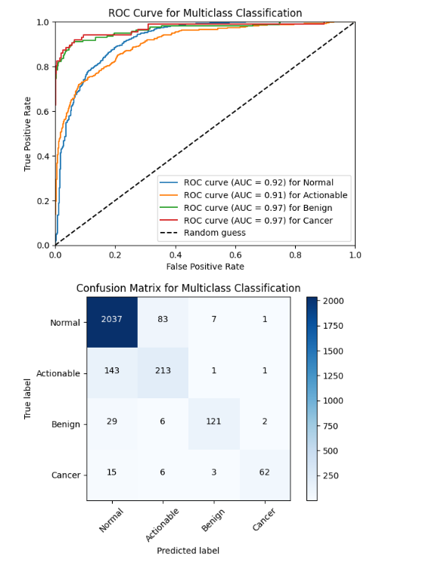
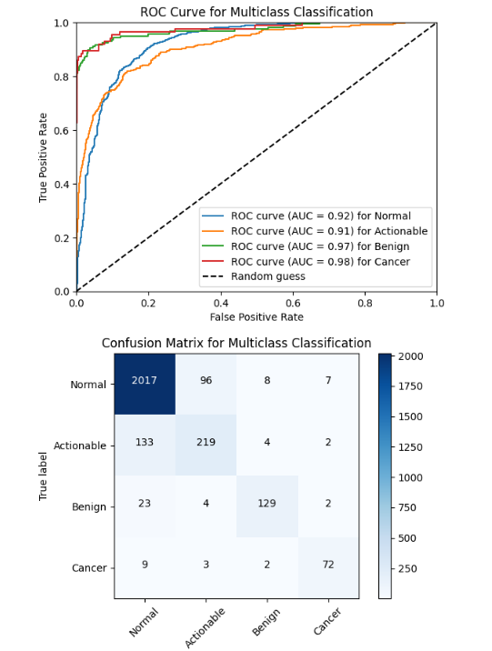
Results CNN 2d
RESNET50
VGG16
 | RESNET50 | VGG16
Overall accuracy | 0.89 | 0.89
Overall sensitivty | 0.76 | 0.88
Overall specificity | 0.91 | 0.92
Overall f1 score | 0.81 | 0.82
Normal sensitivity | 0.95 | 0.94
Actionable sensitivty | 0.59 | 0.61
Benign sensitivity | 0.76 | 0.81
Cancer senistivity | 0.72 | 0.83
Normal specificity | 0.69 | 0.72
Actionable specificity | 0.95 | 0.95
Benign specificity | 0.99 | 0.99
Cancer specificity | 0.99 | 0.99
11

Slide 12
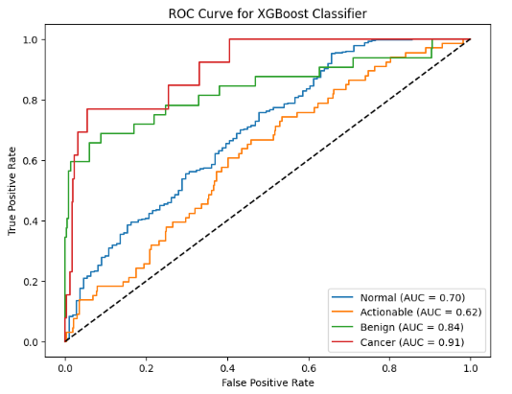
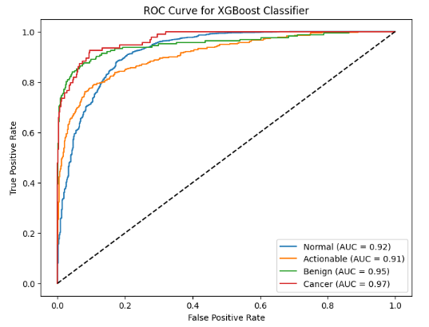
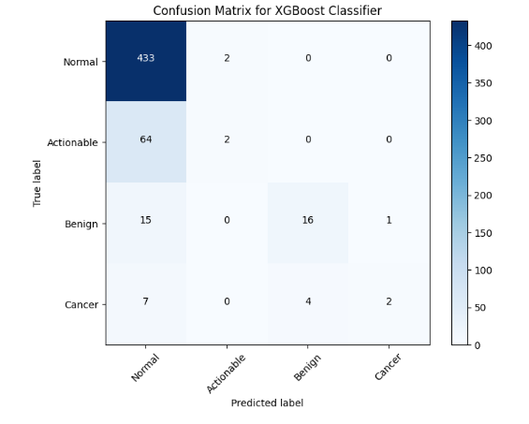
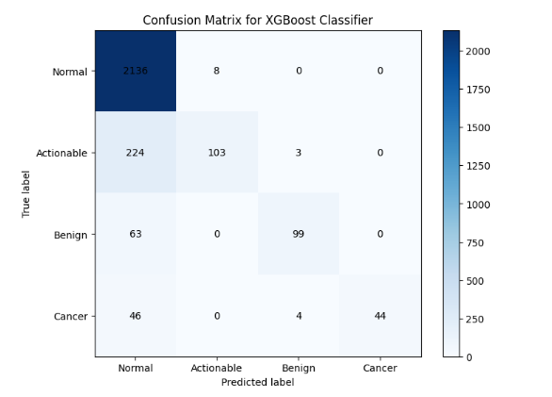










Results XGBoost
XGBoost: Best Parameters: {'colsample_bytree': 0.5, 'learning_rate': 0.1, 'max_depth': 5, 'n_estimators': 500, 'subsample': 0.75}
XGBoost (GPU): Best Parameters: {'colsample_bytree': 0.75, 'learning_rate': 1, 'max_depth': 5, 'n_estimators': 500, 'subsample': 1, '
VGG16 3D accuracy 0.82
VGG16 2D accuracy 0.87
12

Slide 13
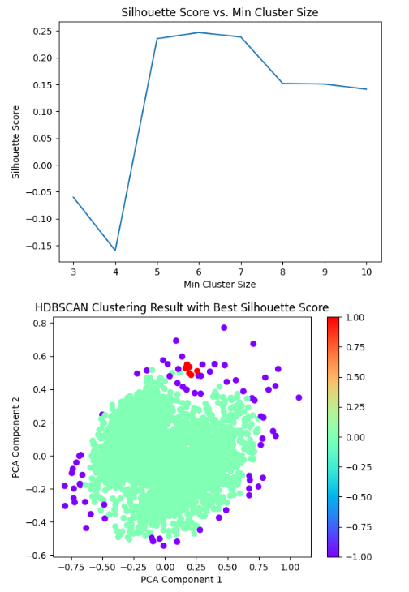
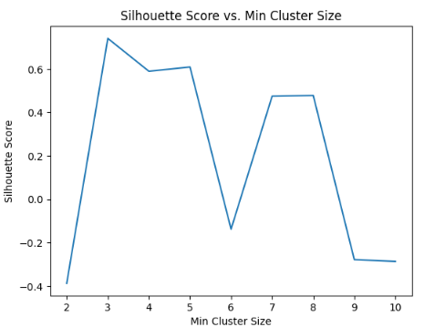
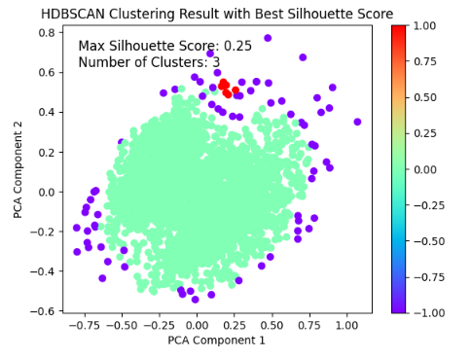
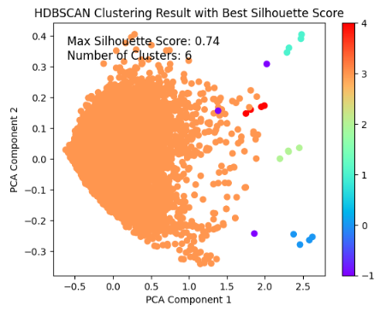

Results Clustering
VGG16 3D
VGG16 2D
13
Notes:
Indicating visual similarity between clusters

Slide 14
Conclusion
Treating dbt as a series of images rather than time-distributed videos is a more effective way of classifying dbt images
CNNs are the leading and most effective way to classify images for breast cancer
Models struggle the most with classifying actionable as normal tumors probably
The database has a healthy individual bias, more cancer, and benign images required for better analysis
Overall models show promise in not identifying the wrong case but struggle to identify the correct case
Future work :
Test and train models on other datasets to decrease generalisability
Hyperparameter analysis on a complete data set (grid search on full data set)
Find more efficient methods to process and run data (memory optimization)
Focused pre-trained model for cancer images specifically
14
Notes:
However we could try in on the full database as accuracy is overestimated due to similarity of images
Vgg 0.89 accuracy 0.81 f1 score

Slide 15
Thank you
for listening!

